Slide 1
UNVEILING THE PAST: A COMPREHENSIVE ANALYSIS OF AIRLINE SAFETY DATASET

Slide 2

INTRODUCTION
In this presentation, we will analyze the Airline Safety Dataset to gain insights into the safety trends in the aviation industry. This comprehensive analysis aims to provide a deeper understanding of the factors impacting airline safety.

Slide 3

DATASET OVERVIEW
The Airline Safety Dataset contains extensive information on ﬂight incidents, accidents, and safety measures. This dataset offers a valuable resource for understanding the historical patterns and trends in airline safety.

Slide 4

SAFETY METRICS
We will examine key safety metrics such as fatalities per million ﬂights, hull loss rate, and incident severity. These metrics provide crucial insights into the overall safety performance of airlines.

Slide 5
HISTORICAL TRENDS
By analyzing historical trends, we aim to identify patterns in safety improvements and vulnerabilities. Understanding the historical context is essential for making informed decisions to enhance airline safety.

Slide 6
RISK FACTORS
We will explore the risk factors contributing to airline incidents, including mechanical failures, human error, and external factors. Identifying these risks is crucial for mitigating potential safety threats.

Slide 7

REGULATORY FRAMEWORK
An analysis of the regulatory framework governing airline safety will provide insights into the role of government agencies and industry standards in ensuring safe operations. Understanding these regulations is vital for maintaining safety standards.

Slide 8
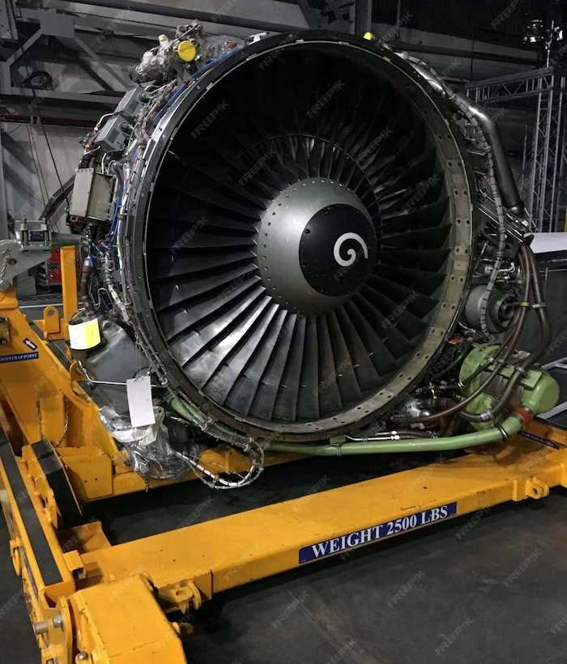
SAFETY INNOVATIONS
We will explore the latest safety innovations in aviation, including advancements in technology, training programs, and safety protocols. These innovations play a crucial role in enhancing overall airline safety.

Slide 9
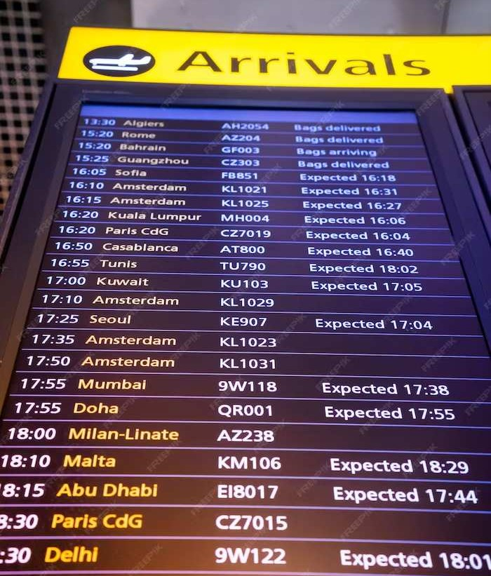
COMPARATIVE ANALYSIS
A comparative analysis of airline safety records across different regions and airline carriers will provide valuable insights into the disparities and best practices. Understanding these variations is essential for driving improvements in safety standards.

Slide 10

PREDICTIVE ANALYSIS
Utilizing predictive analysis techniques, we will forecast potential safety trends and identify areas requiring proactive measures. This forward-looking approach is essential for preemptive safety management.

Slide 11
RECOMMENDATIONS
Based on our analysis, we will propose recommendations for enhancing airline safety, including strategies for risk mitigation, training enhancements, and regulatory improvements. These recommendations aim to drive positive changes in safety standards.

Slide 12
IMPLICATIONS FOR THE INDUSTRY
The ﬁndings of our analysis have signiﬁcant implications for the aviation industry, inﬂuencing safety policies, operational practices, and public perceptions. Understanding these implications is crucial for shaping the future of airline safety.

Slide 13
CONCLUSION
In conclusion, our comprehensive analysis of the Airline Safety Dataset has provided valuable insights into the historical trends, risk factors, and safety innovations in the aviation industry. This analysis serves as a foundation for driving continuous improvements in airline safety standards.

